Slide 1

BFN(Built For Networks)
TEAM :Infrastructure Tanveer Jinabade 011431030
Simerpreet Singh 011443354
Amritpal Sharma 011464648
Komaljit Singh 011817949

Slide 2

SJSU Washington Square
vSphere
A Virtualized Application Hosting Platform on Dedicated Hardware, Powered by VMware
Includes its ESXi hypervisor and vCenter management software
Having features like VMware Virtual SMP, Vmotion Storage, vMotion

Slide 3
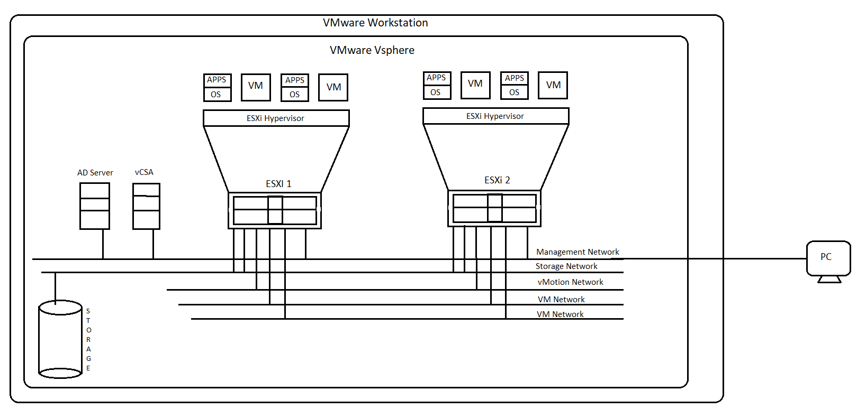
SJSU Washington Square

Slide 4
SJSU Washington Square
ESXi
Type 1 bare-metal hypervisor.
Installs directly on physical server to be partitioned into multiple logical servers or virtual machines.
Simplified Hypervisor Patching and Updating
Reduced Management Overhead
Improved Reliability and Security

Slide 5
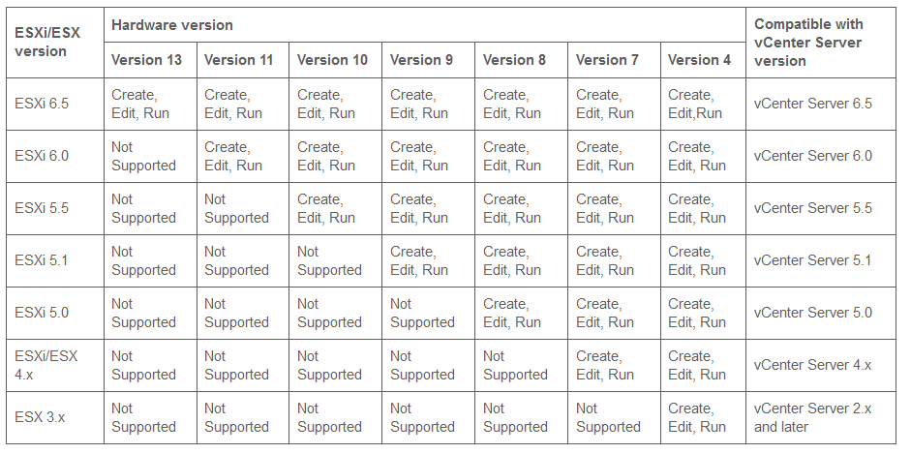
SJSU Washington Square

Slide 6
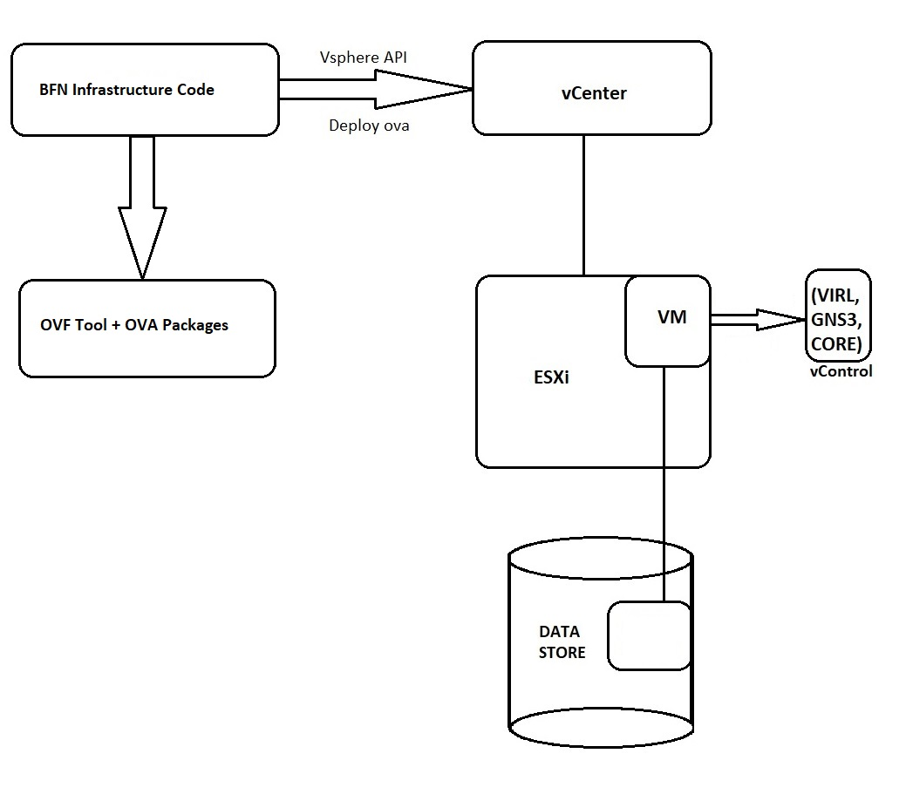
SJSU Washington Square
Block Diagram

Slide 7
SJSU Washington Square
OVF (Open Virtualization Format) Tool
Supports exchange of virtual appliances across products and platforms.
VMware OVF Tool is a command-line utility that allows to import and export OVF packages to and from many VMware products.
OVF and OVA can encapsulate multi-tiered applications and more than one virtual machine.

Slide 8
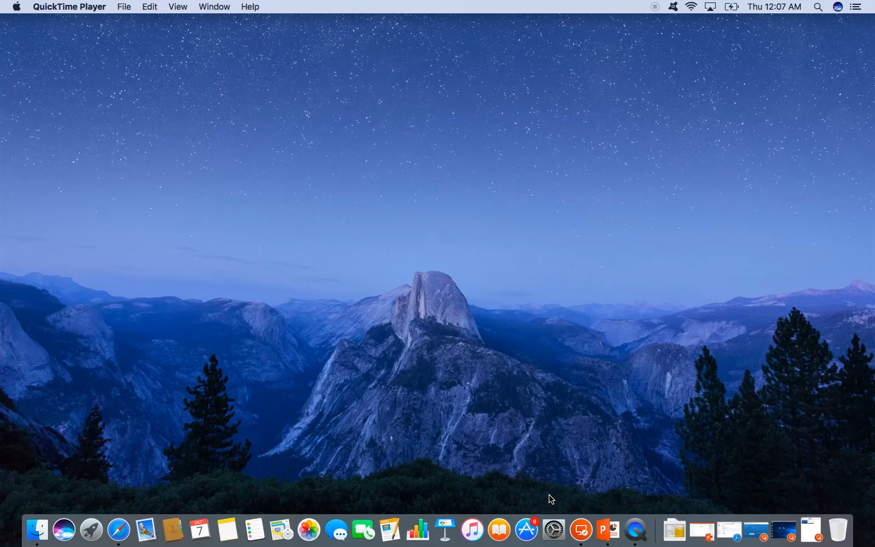
SJSU Washington Square
Demo

Slide 9

SJSU Washington Square

